Slide 1
MY FAVOURITE HOLIDAYS
Name:
Form:
Teacher: Safonova V.G.

Slide 2
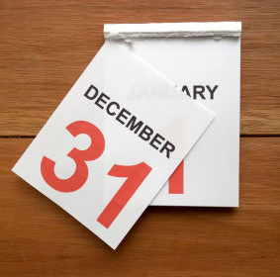
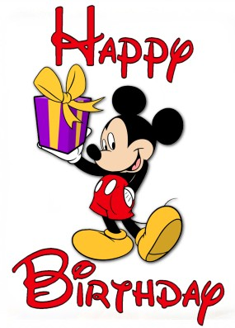
HOLIDAYS & FESTIVALS

Slide 3
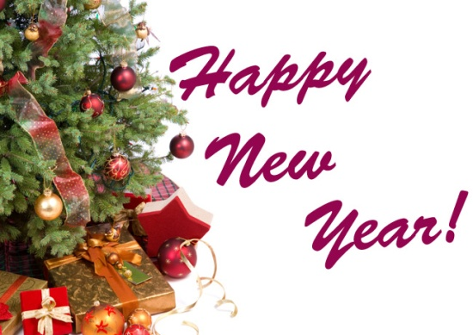
HOLIDAYS AND FESTIVALS

Slide 4
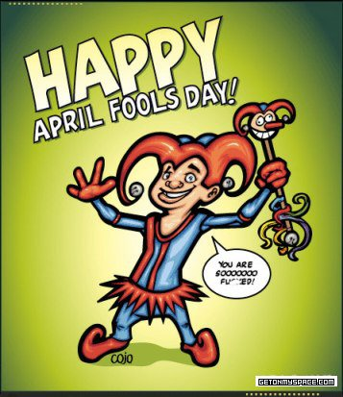
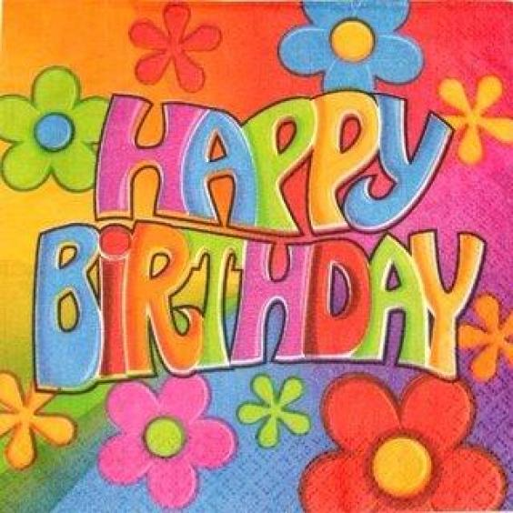
HOLIDAYS & FESTIVALS

Slide 5
INTERNATIONAL WOMEN’S DAY

Slide 6
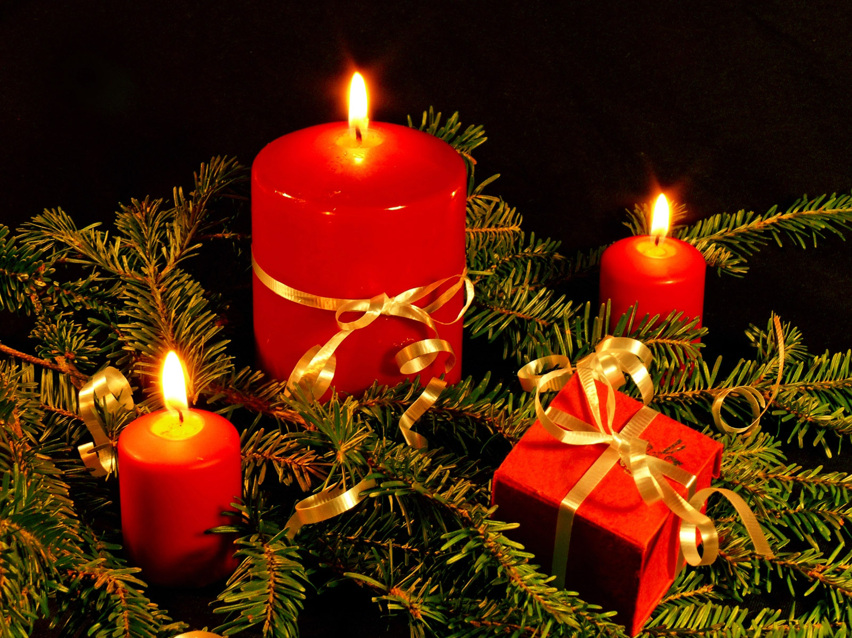
NEW YEAR’S DAY

Slide 7
MY BIRTHDAY – THE 24TH OF …

Slide 8
THANK YOU FOR YOUR ATTENTION

