Slide 1
SHOPPING TIME!
Учитель: Степанова Вера Геннадьевна

Slide 4
What’s the Russian for ‘butcher’s’?
butcher's | газетный киоск
greengrocer's | почта
baker's | аптека
newsagent's | мясная лавка
post office | овощная лавка
chemist's | булочная-пекарня

Slide 5
Match the definitions and the words!
A place where you can buy any medicine | butcher's
A place where you can buy flowers | greengrocer's
A place where you can buy newspapers | chemist's
A place where you can buy vegetables and fruit | newsagent's
A place where you can buy meat products | supermarket
A place where you can buy almost anything | florist's

Slide 6
What can you buy at the….?
chemist's | vegetables
newsagent's | animals
baker's | tablets
greengrocer's | newspapers
pet shop | bread

Slide 7
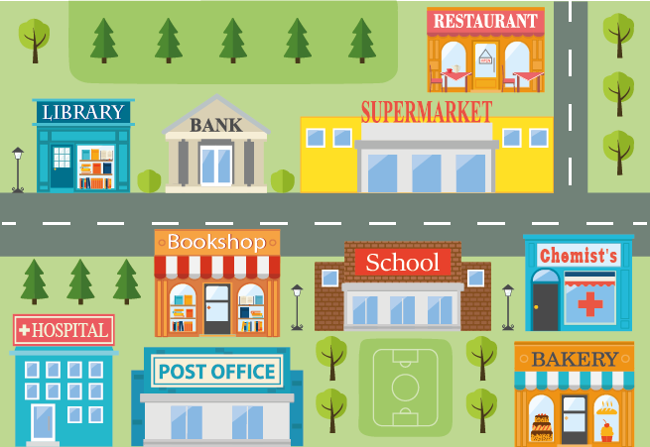
library
hospital
post office
bakery
school
restaurant
bank
1) The ___________ is behind the supermarket. 2) The __________ is between the chemist's and the bookshop. 3) The ________________ is opposite the chemist's. 4) The _______ is to the right of the in front of the bookshop. 5) The _________ is next to the library , to the left of the supermarket.

Slide 8
Match the English phrases and their equivalents
What can I do for you? | Вот, пожалуйста.
What time are you open? | Вам это очень подходит/идёт.
How much is it? | Чем я могу Вам помочь?
Here you are. | Когда вы работаете?
It is over there. | Сколько это стоит?
What size are you? | Вы можете это примерить.
It suits you well. | Это вон там.
You can try this on. | Какой у вас размер?

Slide 9
Make up a dialogue “At the shop”
– It's 260 pounds.
– Ok.
– What size are you?
– I need a dress.
– Oh, thank you.
– How much is it?
– What can I do for you?
– I'm 6.
– Here you are.
– You can try this on.
– It suits you well.

Slide 10
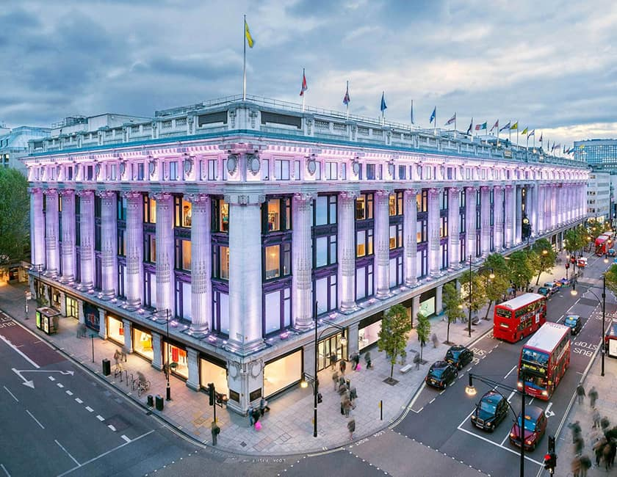

Slide 11
Read the text and choose the true statements.
Selfridges is London's most famous department store and the second largest shop in the UK. It was opened by an American, Gordon Selfridge, in 1909. Today you can’t walk down Oxford Street without noticing its monumental entrance with a statue of the Queen of Time. The shop has six floors of shopping paradise where you can find whatever you need, 11 places to eat, two exhibition halls and lots of different services. Selfridges is the largest department store in the UK.
1) It was founded by a famous Englishman.
2) It was opened in the early 20th century.
3) It is situated in Oxford Street.
4) There is a statue of the Queen of Time inside the building.
5) There are 6 storeys there.
6) They offer different services there.

Slide 12
Now I know
Types of shops
Departments
Products
Now I can
Make up a dialogue “At the shop”
I learnt about
The most famous department store in the UK

