Slide 1
Учитель: Степанова Вера Геннадьевна

Slide 2
Now I can
Make a birthday party plan and discuss birthday treats
Order food in a café or at a restaurant
Discuss a balanced diet, speak about the Food Pyramid
Now I know
The names of food and drinks
Different groups of food (fruits, vegetables, drinks, dairy products, fast food, snacks)
Different meals (breakfast, lunch, tea, dinner)
Containers (a carton, a cup, a glass, a bar, a jar)
I would like to learn
Tastes
Ways of cooking
Kitchen machines and tableware
Kitchen rules

Slide 3
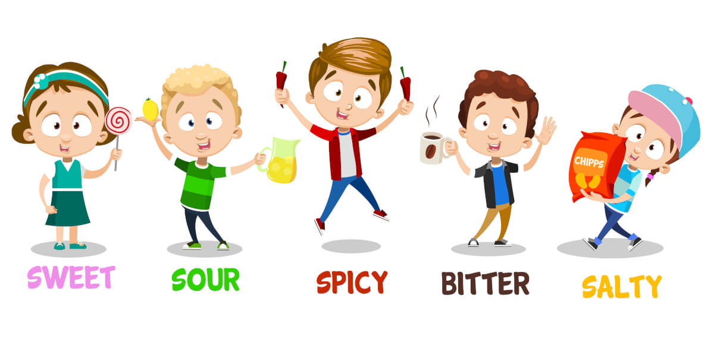
TASTES DIFFER
I like cakes, because they are sweet.
I don’t like lemons, because they are sour.

Slide 4
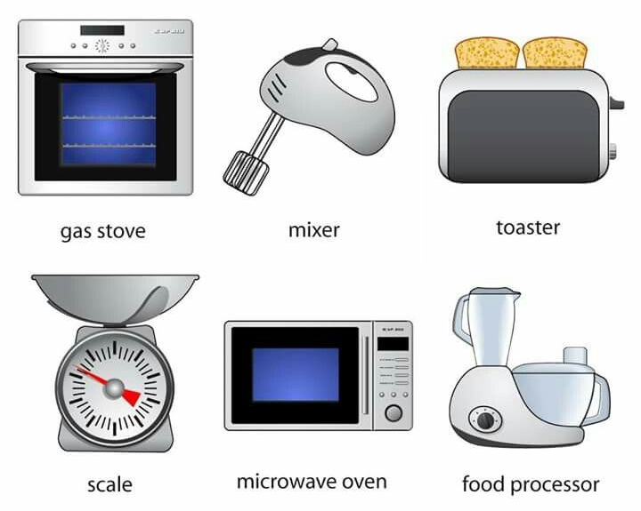
KITCHEN MACHINES

Slide 5
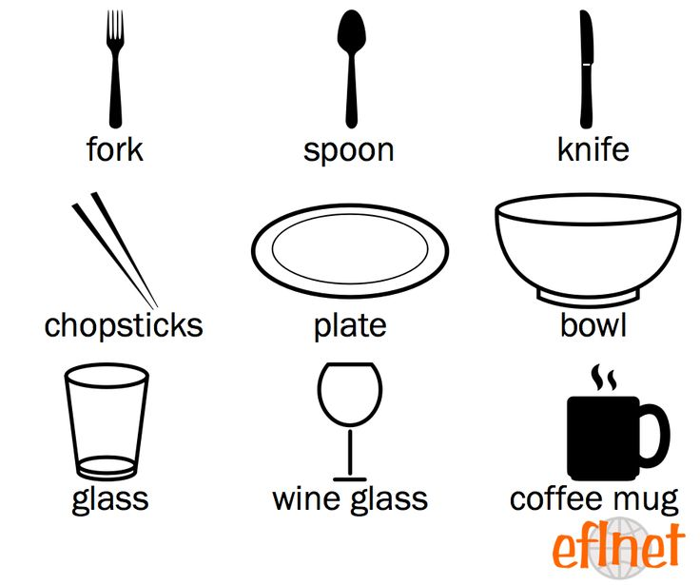
KITCHEN TABLEWARE

Slide 6
CORRECT THE MISTAKES
It is not a spoon. It is a s……………..
It is not a ………. It is a ……………….

Slide 7
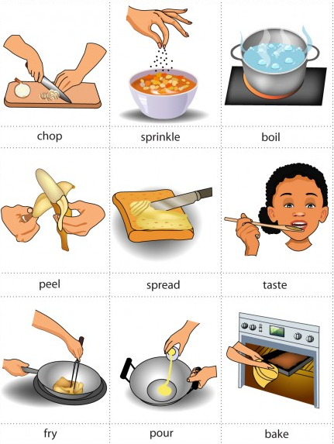
COOKING VERBS
ЧИСТИТЬ
ПЕЧЬ (ПИРОГИ)
ИЗМЕЛЬЧАТЬ
НАМАЗЫВАТЬ
ПОСЫПАТЬ
ПРОБОВАТЬ
ВАРИТЬ
ЖАРИТЬ
НАЛИВАТЬ

Slide 8
MATCH THE PICTURES AND THE SENTENCES
The girl is pouring some water.
The cook is dicing the carrots.
The cook is frying fish.
The cook is stirring the soup.
The cook is peeling potatoes.

Slide 9
Complete the sentences with the Present Simple or Present Continuous form of the verb in brackets.
1) They usually (buy) fresh vegetables from the market. 2) Steve (make) some apple juice now. Would anyone like some? 3) I (cook) with my friend Jamie at the moment. 4) My parents (go) to the restaurant on Saturdays. 5) Antony (have) lunch every day at 1 o’clock in the afternoon.

Slide 10
Now I know tastes,
tableware,

Slide 11
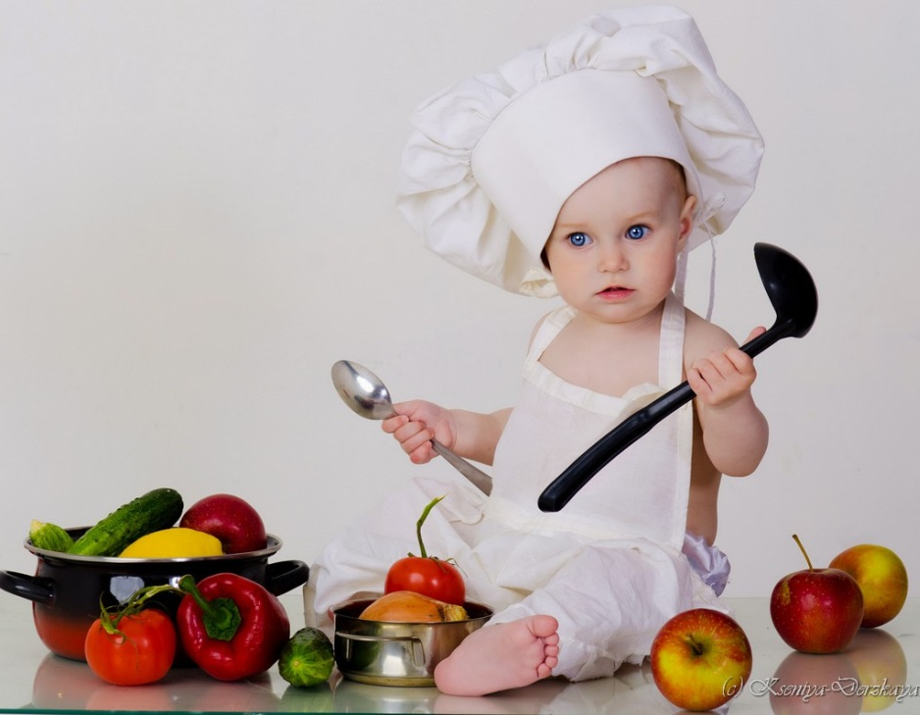
ЧИСТИТЬ
ПЕЧЬ (ПИРОГИ)
ИЗМЕЛЬЧАТЬ
НАМАЗЫВАТЬ
ПОСЫПАТЬ
ПРОБОВАТЬ
ВАРИТЬ
ЖАРИТЬ
НАЛИВАТЬ
cooking verbs

Slide 12
THE KITCHEN RULES
Wash you hands before you cook or eat.
Keep meat and fish in the fridge.
Don’t touch hot frying pans and saucepans.
Put milk and milk products back in the fridge.
Wash fruits and vegetables before you eat them.
Clean the table really well to keep bacteria away.
Don’t play computer games when you are cooking.
Never let pets in the kitchen.
Wash your plate and cup after meal.
Roll up sleeves and tie hair back.
Keep away from hot water.

Slide 13
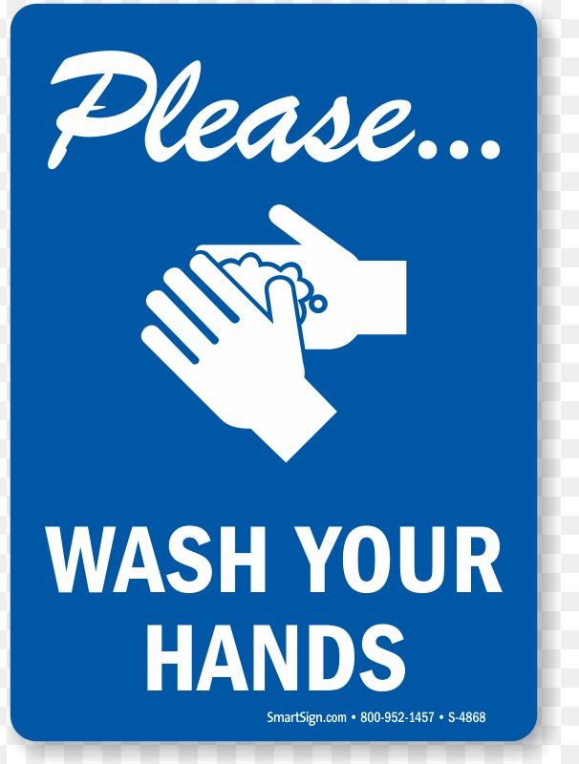
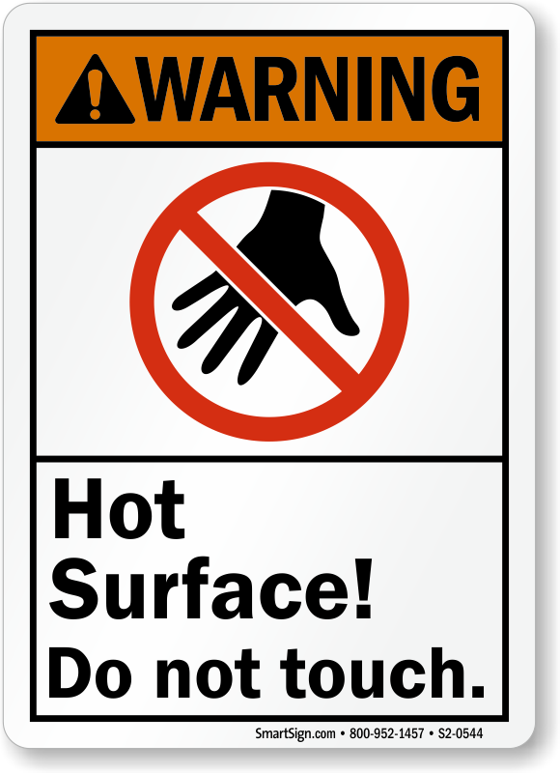
MY KITCHEN RULES

Slide 14
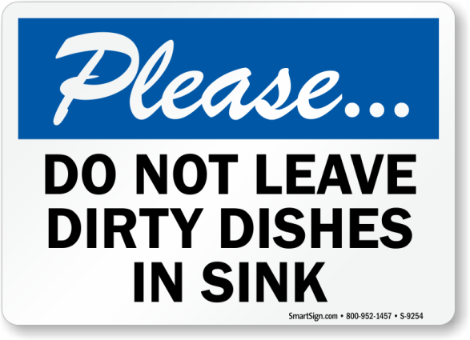
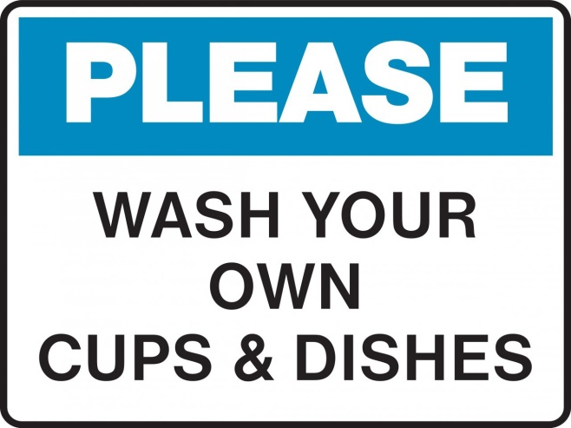
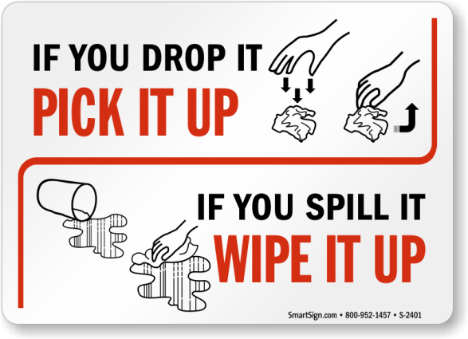
MY KITCHEN RULES

Slide 15
Now I know
Tastes
Ways of cooking
Kitchen machines and tableware
Kitchen rules

