Slide 1
ПРЕЗЕНТАЦИЯ К УРОКУ АНГЛИЙСКОГО ЯЗЫКА “HEALTHY FOOD”
АВТОР:
СТЕПАНОВА ВЕРА ГЕННАДЬЕВНА

Slide 2
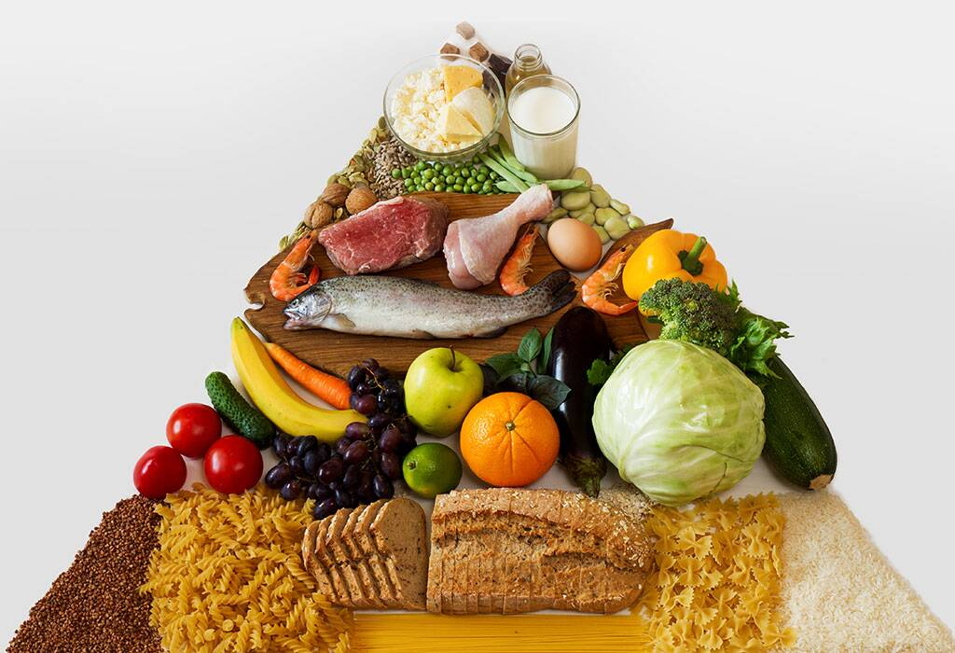
WHAT’S THIS?

Slide 3
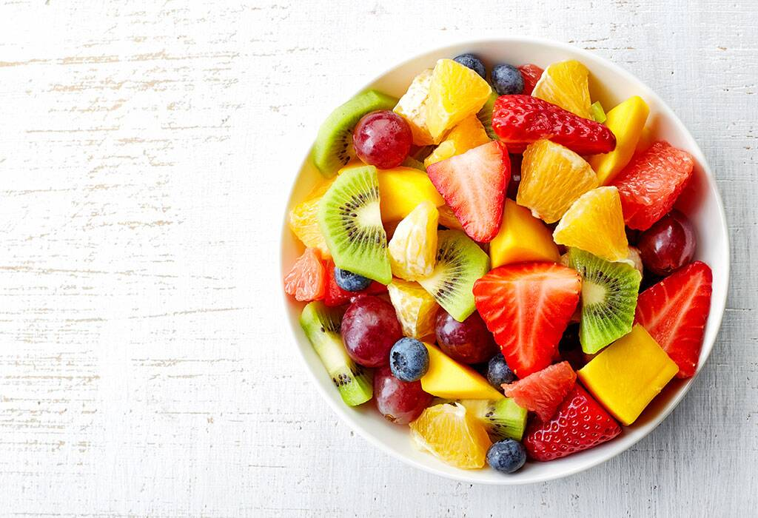
FRUITS AND BERRIES

Slide 4
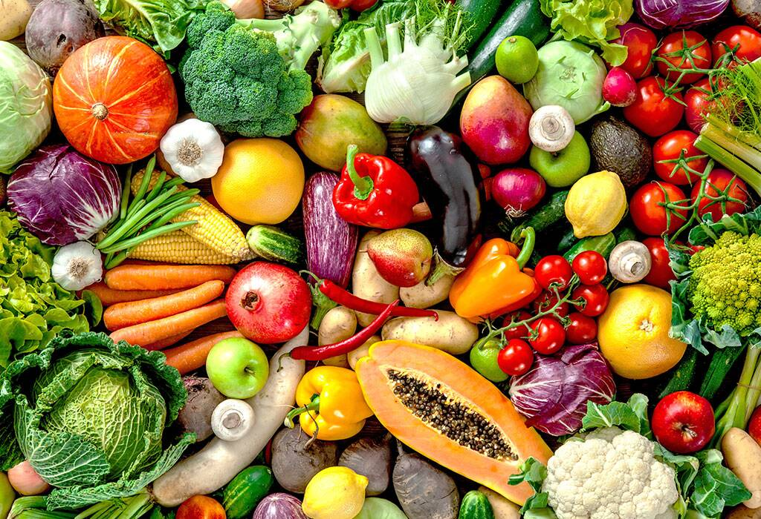
VEGETABLES

Slide 5
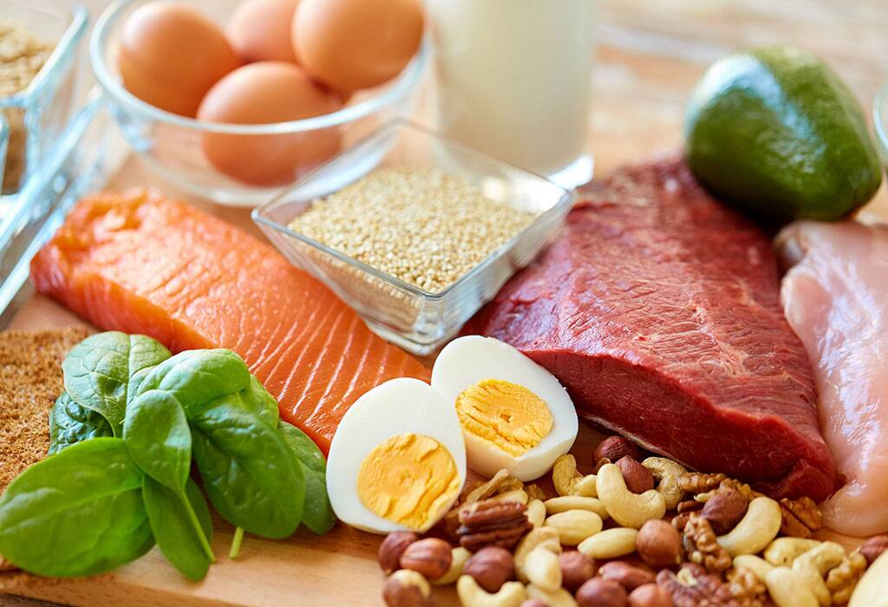
MEAT, FISH, NUTS AND EGGS

Slide 6
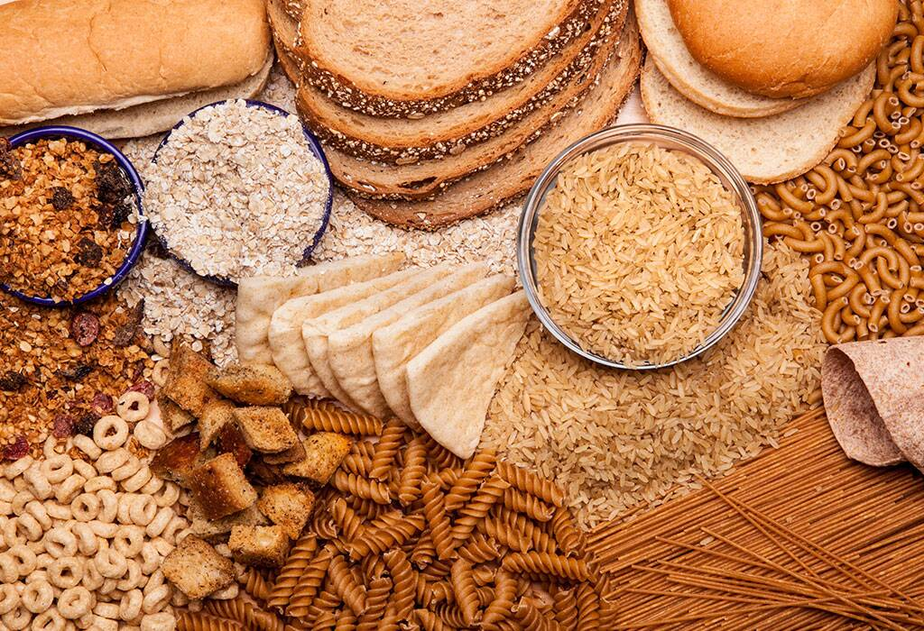
BREADS AND CEREALS

Slide 7
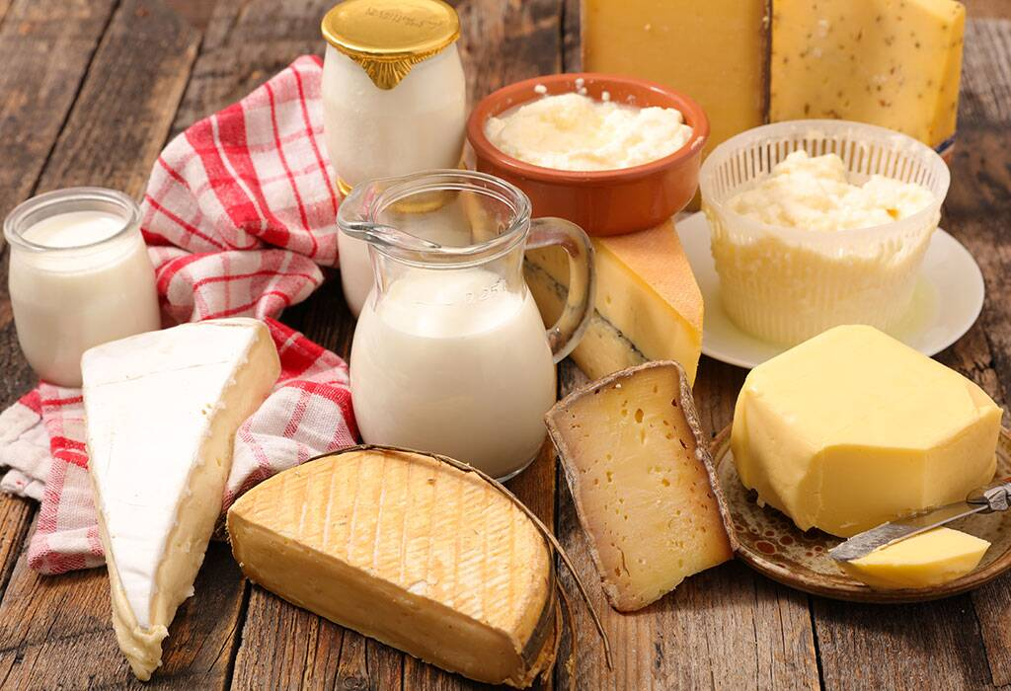
DAIRY PRODUCTS

Slide 8
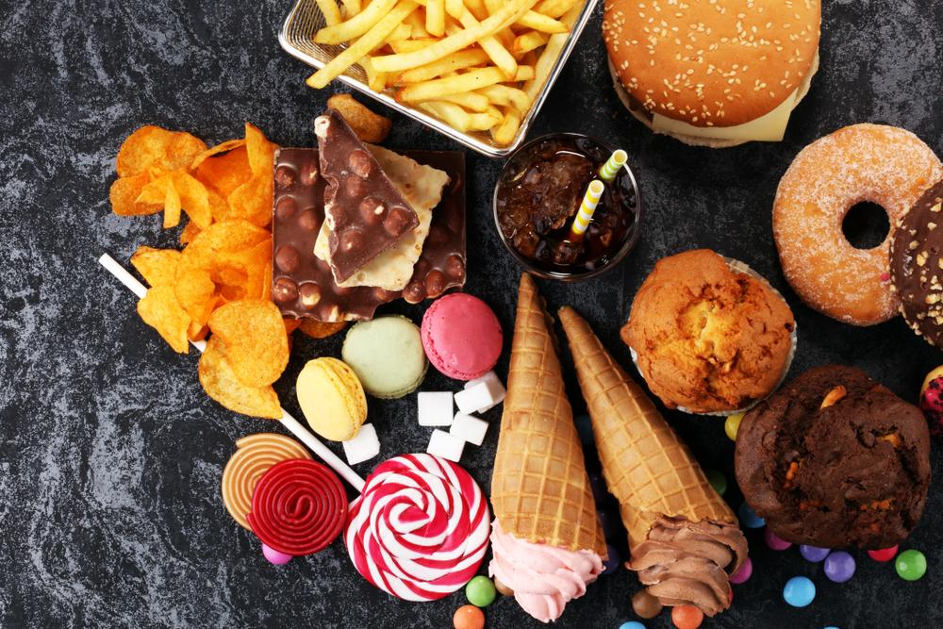
SWEETS AND SNACKS

Slide 9
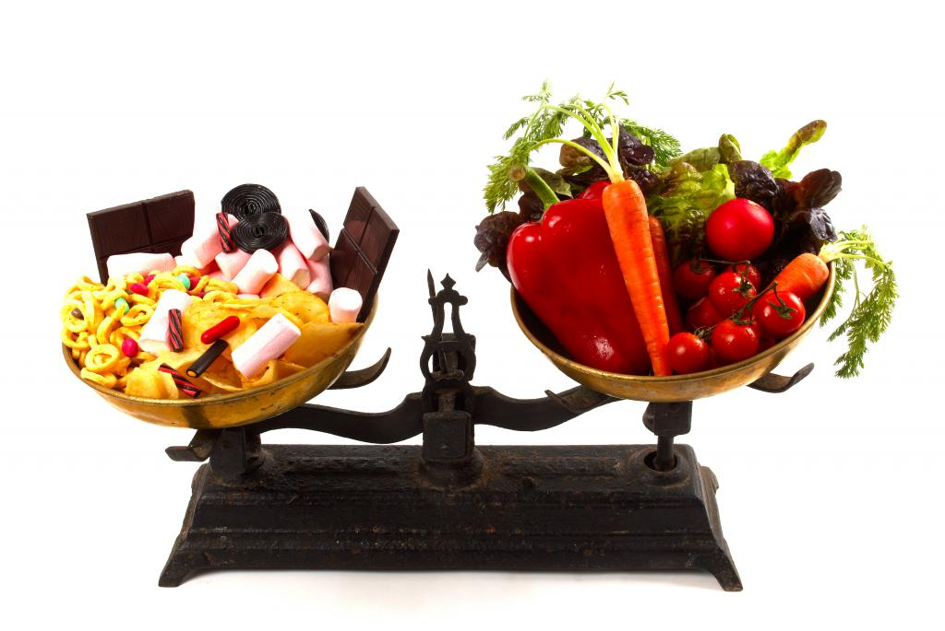
WHAT IS MORE IMPORTANT FOR OUR HEALTH?

Slide 10
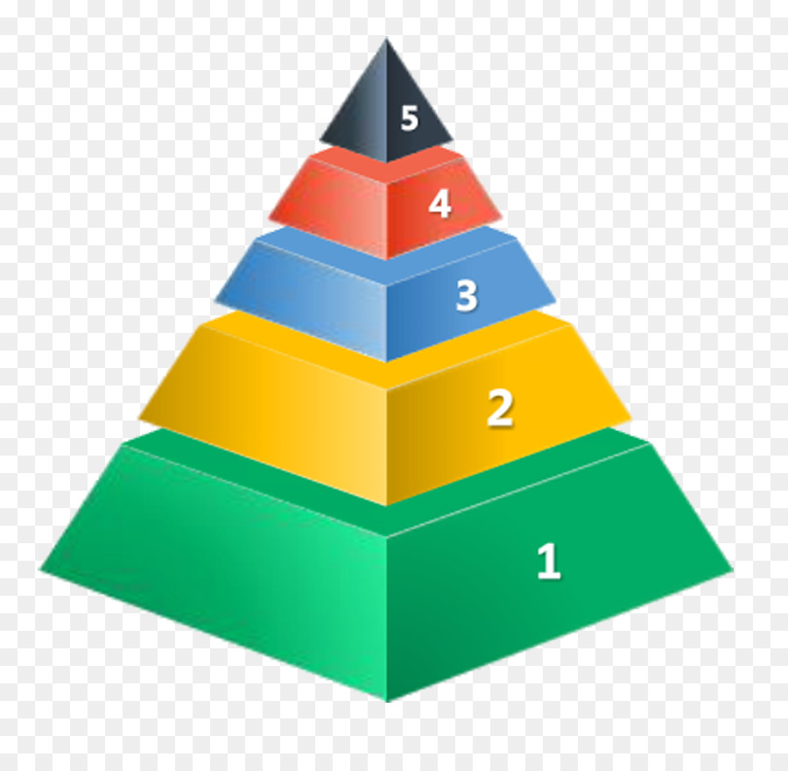
AT THE TOP
IN THE MIDDLE
AT THE BOTTOM

Slide 11
